Slide 1
Team 16
Knuckles, The Robotic Arm
Andrew Blanchard (Team Leader), Matthew van Zuilekom, Rym Benchaabane, Paola Hernandez
ECE 4336: ECE Design II
Faculty: Dr. Dmitri Litvinov
Faculty Advisor: Dr. Becker
Tuesday, April 2nd 2019
Sponsored by IEEE UH Makers
Notes:
Andrew

Slide 2
Overall Project
What is Knuckles?
A voice activated, assistive robotic arm that will hand the user objects and tools upon request
Purpose
Assist those who are limited in physical capacity
Decrease the risk of dexterity incidents
Increase the user’s productivity
Examples of users
Elderly
People with disabilities
Lab researchers
Notes:
Andrew

Slide 3
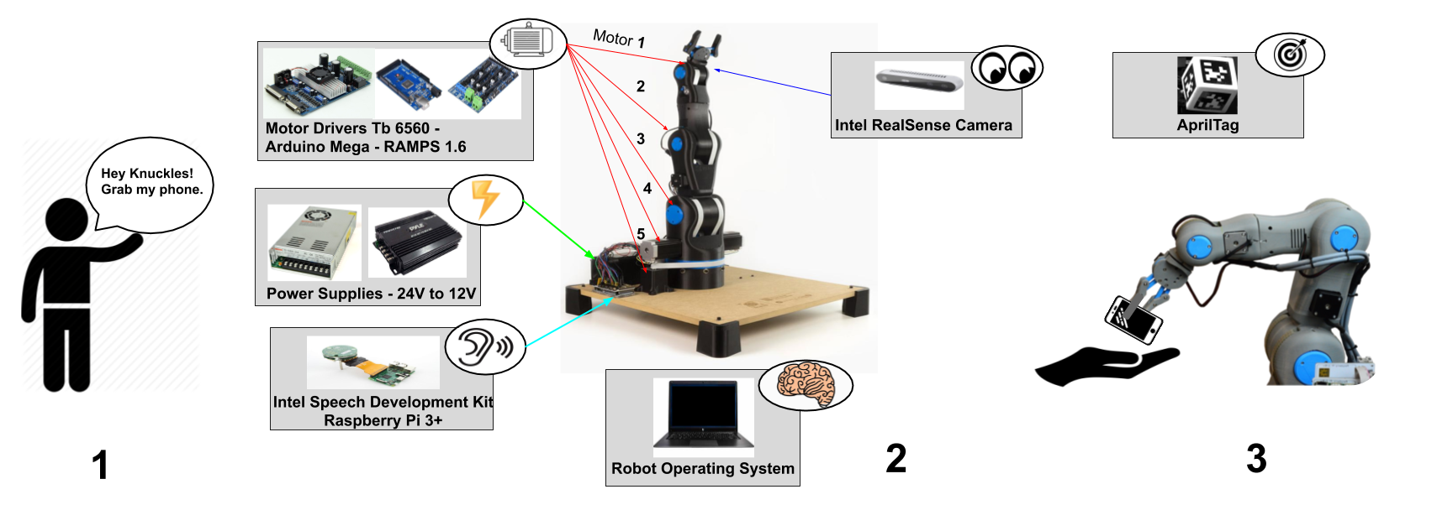
Overview Diagram
Figure 1. Overview of Knuckles functionalities
Notes:
Andrew

Slide 4
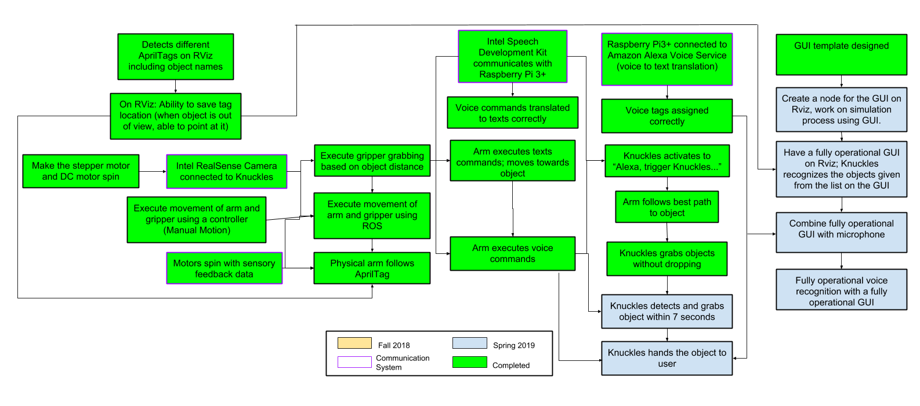
Target Objective - Goal Analysis
Figure 2. Goals and work progress
Notes:
Andrew

Slide 5
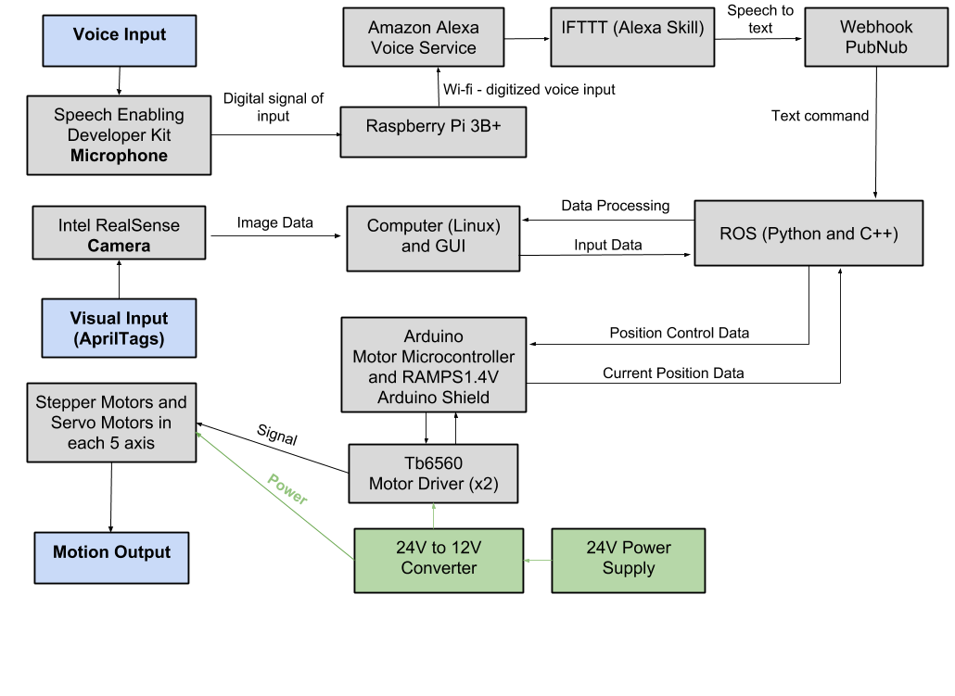
Design Considerations
Figure 3. Modular Diagram of Knuckles system
Notes:
Matthew

Slide 6
Design Constraints
Limited time
Less time to optimize the gripper design to accommodate more shapes
Limited weight to lift
Notes:
Paola

Slide 7
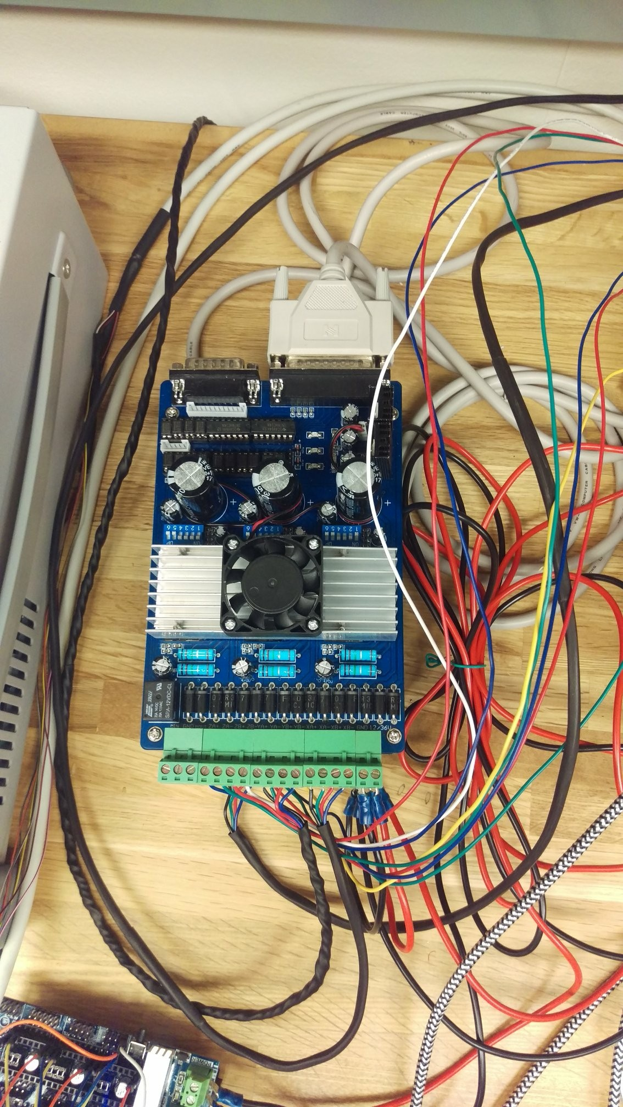
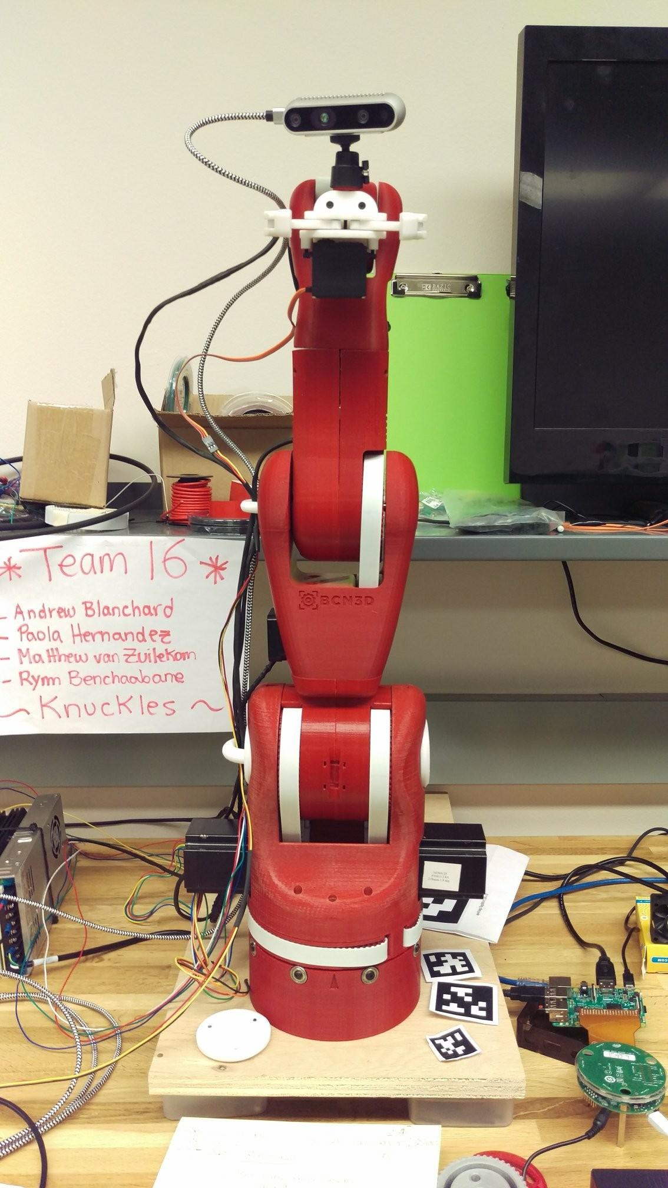
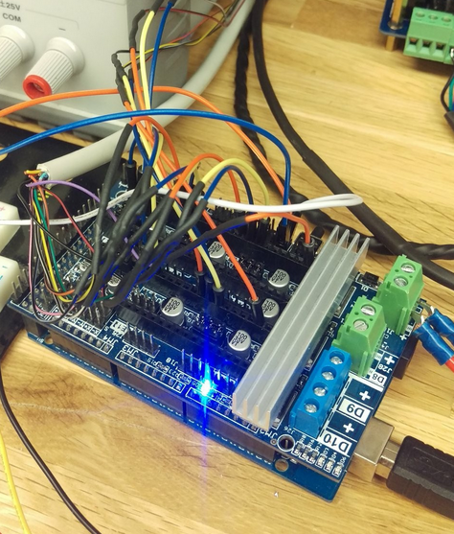
Figure 4. Arduino Mega 2560 with a RAMPS V1.4 shield connects to computer using USB serial connection
Figure 5. Tb6560 stepper drivers
Figure 6. Knuckles, the robotic arm
Notes:
Matt

Slide 8
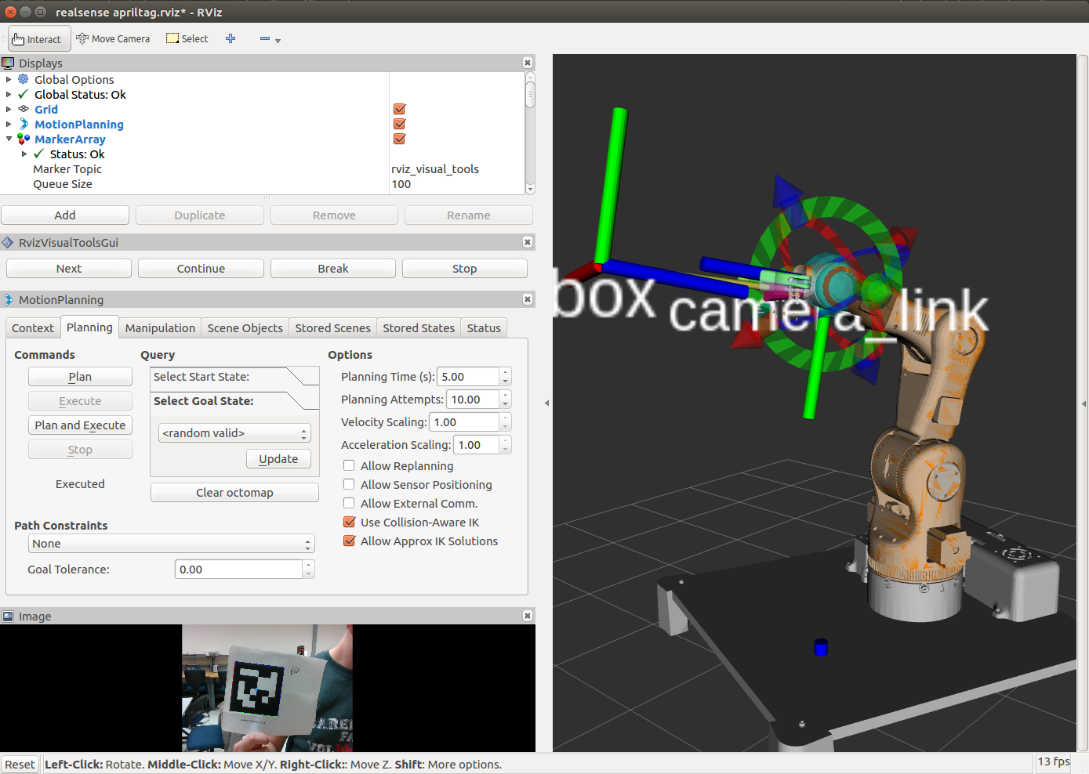
Figure 8. Knuckles model & AprilTag visualization on Rviz, ROS
Notes:
Matt

Slide 9
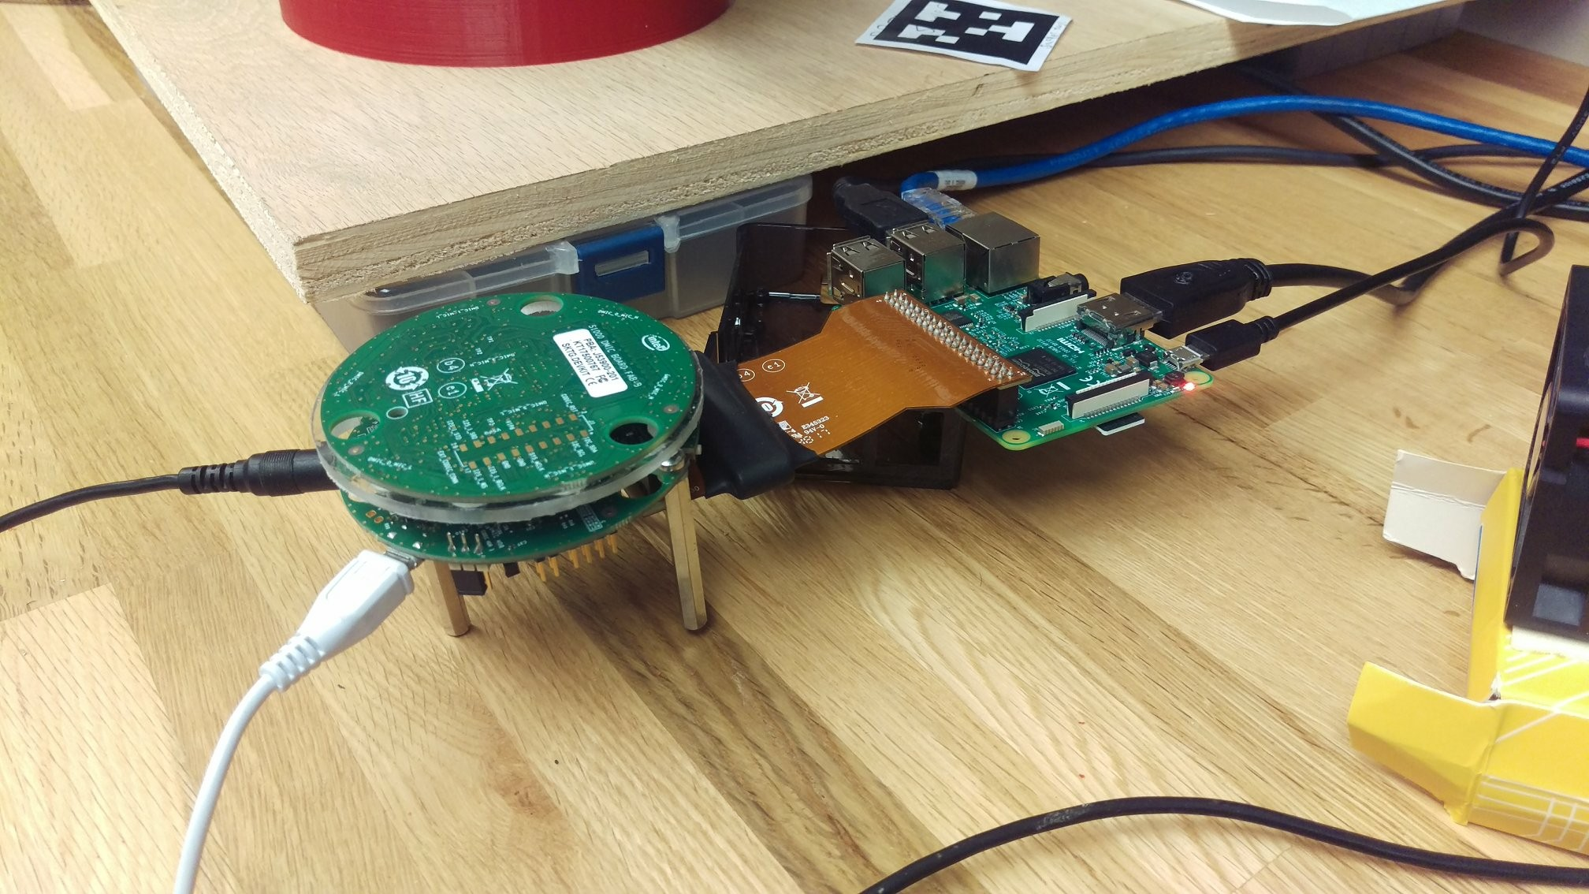
Figure 7. Raspberry Pi 3 B+ and Intel Speech Enabling Development Kit
Notes:
Matt

Slide 10
Voice Commands
Knuckles activates with: "Alexa trigger Knuckles to"
From Workspace to Knuckles
"Pick up"
From Workspace to User
"Hand me"
"Give me"
"Bring me"
"Get me"
From Knuckles to Workspace
"Put Down"
From Knuckles to User
"Release"
"Let Go"
From User to Knuckles
"Take"
"Grab"
"Hold"
Knuckles Settings
"Scan for objects"
"Go Upright"
"Go Down"
"Default"
"Stop"
"That it recovered"
"Forget saved objects"
"Restart"
Objects aka April Tags
"Apple"
"Bottle"
"Wallet"
"Phone"
"Box"
"Tape"
"Cup"
"Bag of Chips"
"Hand/User"

Slide 11
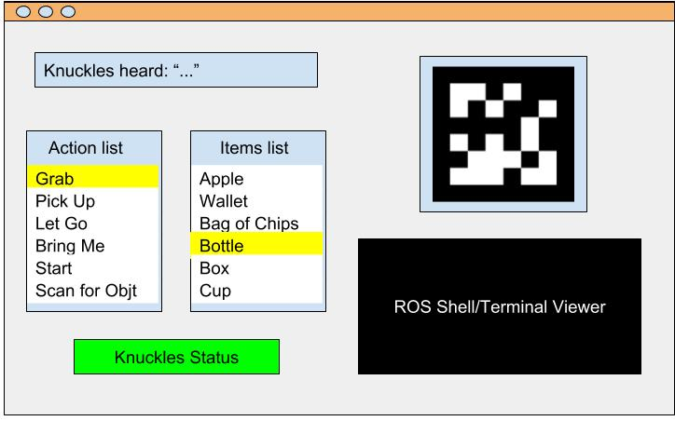
Graphical User Interface (GUI)
Figure 9. GUI template
Notes:
Paola

Slide 12
Specifications
Degrees of Freedom (DOF) Arm – Five
Accuracy Voice Interpretation – 99.999%
Minimum Voltage for Motors – 12V
Object Detection – AprilTags
Object Count Library – 9
Response phrases - 64
Response Time – 7 seconds
Maximum Grabbing Reach – 0.5 meter
Maximum Weight Rating – 0.5 kg
Notes:
Paola

Slide 13
Features
Powered by Mains – Yes
Integrated Microphone – Yes
Integrated Camera – Yes
Object Detection – AprilTags
Voice-Controlled using Alexa Voice Service – Yes
User-Friendly GUI – Yes
Wi-Fi required – Yes
Notes:
Paola

Slide 14
Deliverables
Table 1. Deliverables in Spring 2019
 | SPRING 2019
Assembling: Tune gripper and arm motors motion (100%) | User Interface: Develop a Graphic User Interface (QTdesigner) (25%)
Hardware Implementation Mount and install on Arm (Intel RealSense camera, Intel mic) (90%) | Automation Control: Arm moves using data from ROS (100%)
Object Detection: Arm follows AprilTag (100%) | Voice Recognition: Convert voice to speech speech to object detection (100%)
Communication System: Receive Feedback Signals from all hardware on ROS (100%) | Physical Arm Final Build: (45%)
SPRING 2019
Notes:
Rym

Slide 15
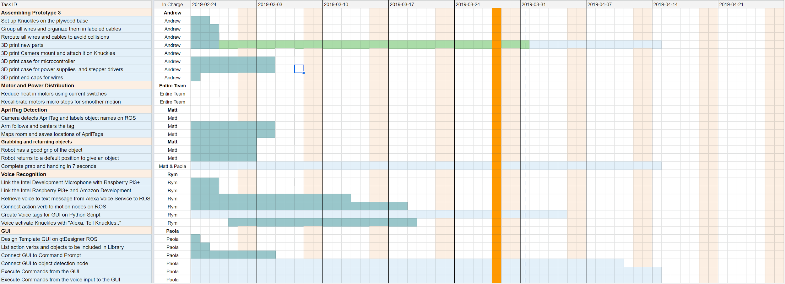
Gantt Chart - Spring
In Progress
Completed
Delay
ECEDHA Conference
Deadline
Notes:
Rym, also talk about Test Plan

Slide 16
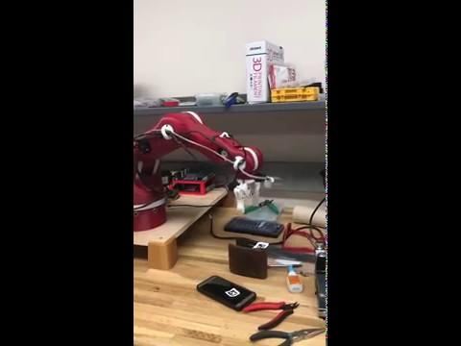
Progress
Knuckles working:
https://drive.google.com/file/d/123lOtuc2agro6aVnJTlNUOi3Wmk7g6Ug/view

Slide 17
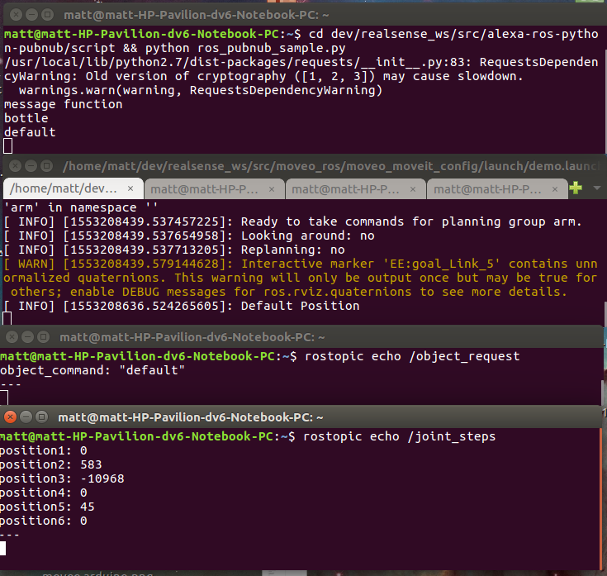
Progress
Knuckles responding to a voice command:
ROS receives command from Alexa Voice Service, via IFTTT/PubNub
Knuckles receives and processes command
ROS response, Knuckles moves to this pose

Slide 18
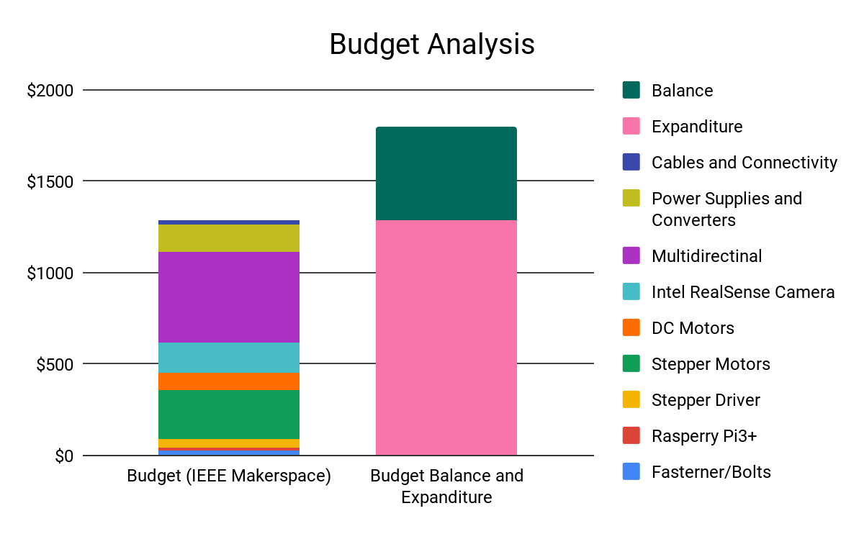
Total Budget
Thank you IEEE UH Makers, Dr. Roysam & Dr. Becker!
Budget
IEEE UH Makers
.
Total Budget: $1,800
Used 70.2%
Figure 9. Budget
Notes:
Rym

Slide 19
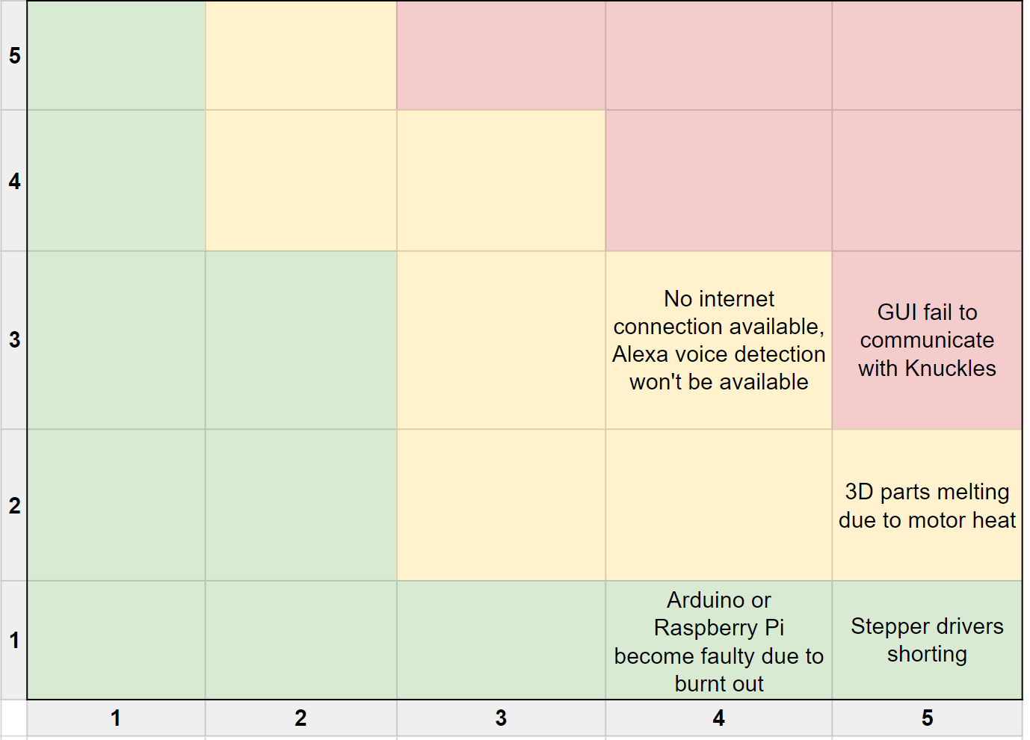
Risk Management Matrix
Damage during shipping
Probability
Consequence
Figure 10. Risk management matrix
Notes:
Matthew

Slide 20
Risk Mitigation
GUI fail to communicate with Knuckles
Voice to text input will still be functional
No internet connection available, Alexa voice detection unavailable
Text input will still be functional
3D parts melting due to motor heat
Can re-print melted parts and/or replace motors
Damaged arm due to shipping packaging
Reprinting damaged parts
Stepper drivers shorting
Have four extra stepper drivers as replacements
Arduino or Raspberry Pi become faulty due to burnt out connections
Can get replacements at Library Makerspace
Notes:
Matthew

Slide 21
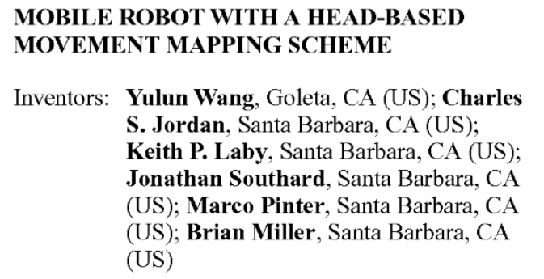
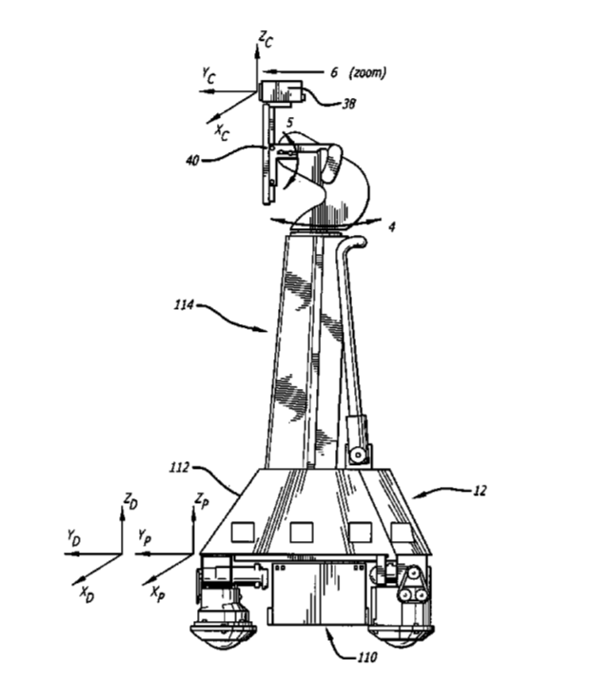
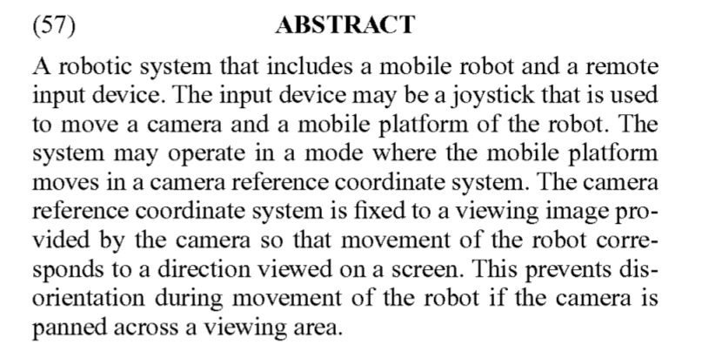
Patent Search 1
Claims:
A mobile robot system that is controlled through an input device, comprising of a camera located in a camera coordinate system and an input device.
Input device is a joystick.
Twisting joystick causes rotation of the camera and pivoting causes mobile robot to move.
Remote control system with a camera coupled to a monitor.

Slide 22
Patent Search 1
Similarities
Head-based movement mapping scheme.
Differences
The base of Knuckles is secured to a stand rather than being mobile.
The camera in the patented robot maps the room, while Knuckles uses the camera map and search for items in the workspace.
Knuckles’ camera is fixed to the arm, facing the gripper and cannot be repositioned without human assistance or collision.
Knuckles’ movement is controlled by a motion planning framework rather than a joystick.

Slide 23

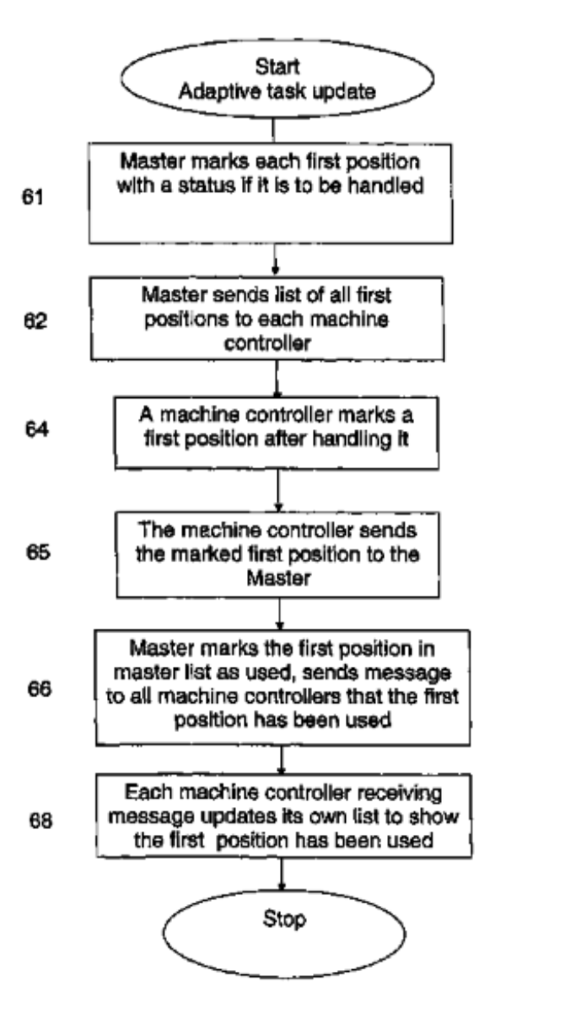
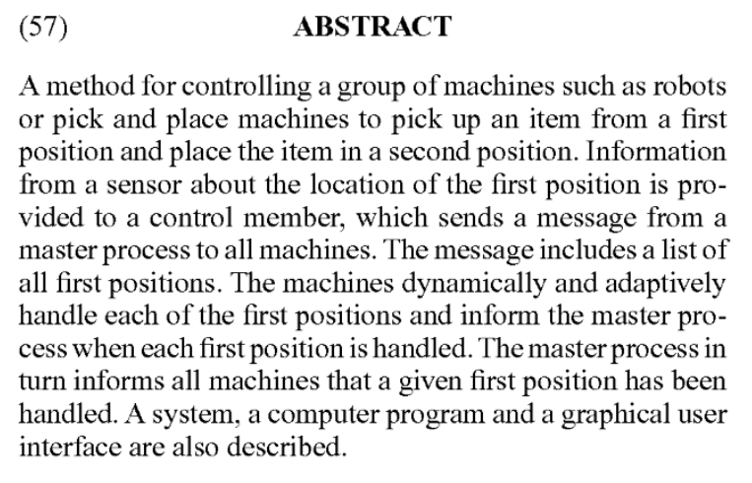
Patent Search 2
Claims:
Computer program designed to control a class of robots to pick and place an object while informing a master controller the first and second position before and after picking up the object.
Sensor based movement.
A graphical user interface (GUI) is also in used to choose and see which positions the robots go to pick up an item.

Slide 24
Patent Search 2
Similarities
Sensor based movement.
Computer programmed to pick up objects.
Only one item could be picked up and released, like Knuckles.
Differences
Algorithm and code is hard-coded so the first position of the pick up item does not become the second position for the release of the item. Knuckles does not generate an algorithm to stay within a specific place, it looks for a tag in order to move.
Program is developed for a group of robots, our code is only for one robot, Knuckles.

Slide 25

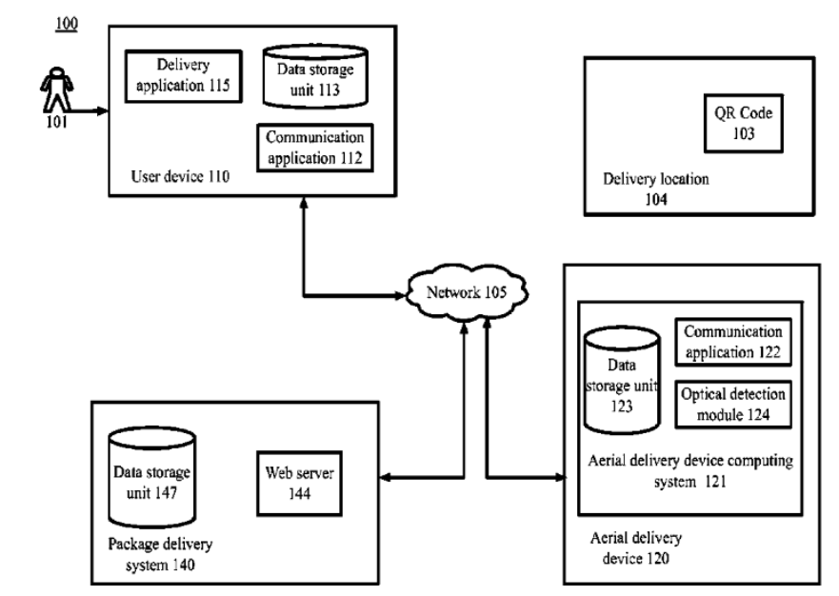
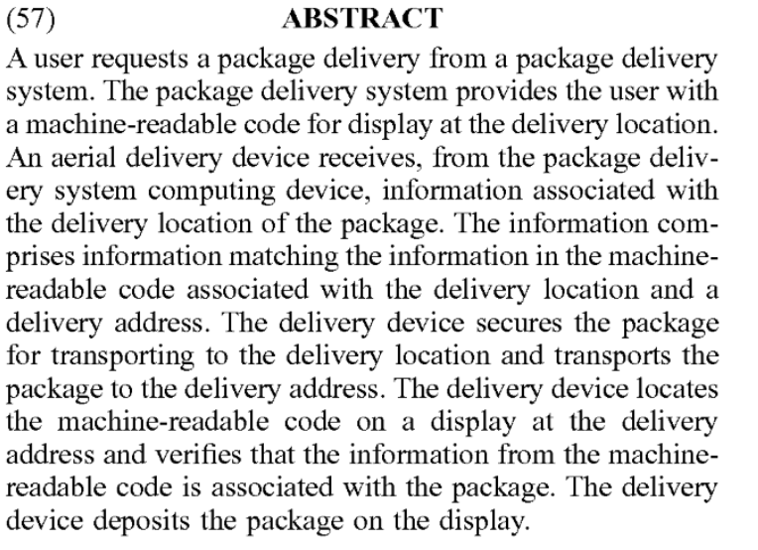
Patent Search 3
Claims:
Computer implemented method to automate package deliveries, where delivery location is shown by a printed image for display at a particular location.
Delivery location information also contains a GPS location and address,

Slide 26
Patent Search 3
Similarities
Printed image is used to recognize item/location, and needs to be seen by the camera to be recognized.
Usage of a form of QR code (AprilTag) to recognize object
Differences
AprilTag does not provide GPS location or an address.
Larger geographical scale than our project that is limited to a workspace.

Slide 27
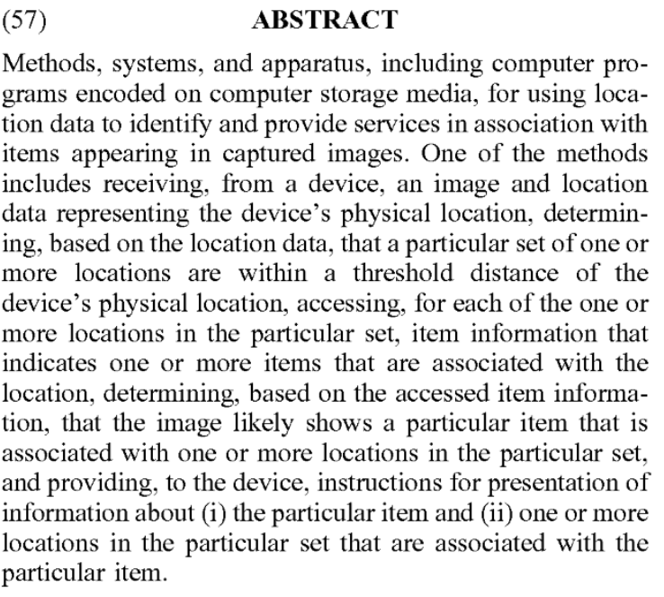
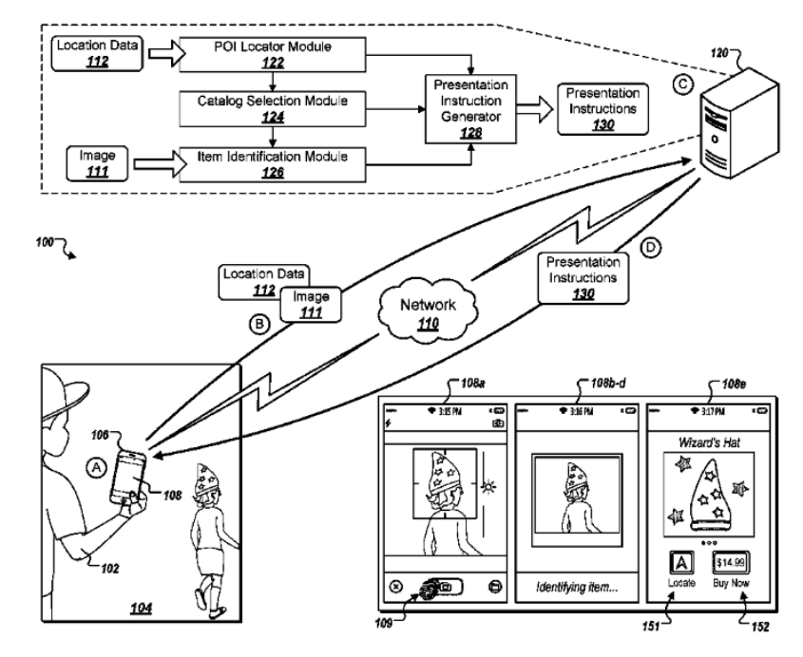
Patent Search 4
Claims:
Computer program specialized on object recognition from an image, and connection to a web browser so find the object in store near the user.
Program works with Internet connection.
System includes clients and servers.

Slide 28
Patent Search 4
Similarities
Object recognition is done from an image.
Connection to the internet; retrieves info from a server.
Differences
Connection to the Internet uses IP address of the user to locate him or her to the nearest store.
System mostly used for shopping, Knuckles is an aid system.

Slide 29
Project Conclusion
Assistive robotic arm, increase productivity
Great opportunity to learn about robotics, Linux & ROS
Patent: Arm and foundation software is open-source. Our project will also be open-source.
Current progress
Knuckles able to move to object and pick it up
Voice detection operational, need to convert to text
Third and final arm construction in progress.
Notes:
Rym

Slide 30
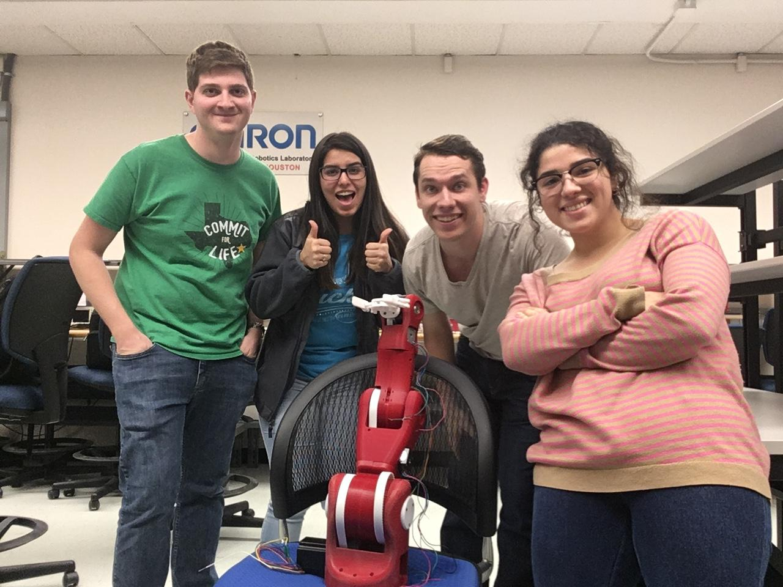
Thank you for your attention
QUESTIONS?
Notes:
Yay

